Slide 1
Binary Trees
Data Structures and Problem Solving
COMP232
Dickinson College
Slides adapted by John MacCormick from material created by Professor Grant Braught, with additions by Professor Farhan Siddiqui

Slide 2
Binary Trees
Tree is a non-linear data structure which organizes data in a hierarchical structure
A binary tree is a tree with:
Nodes that have 0, 1 or 2 child nodes
Children are distinguishable: left / right
Some binary trees:
Notes:
One on the right may not look like a binary tree, but technically it is - it is just highly unbalanced.
Draw another on the board where it zig-zags (right child / left child / right child etc…)

Slide 3
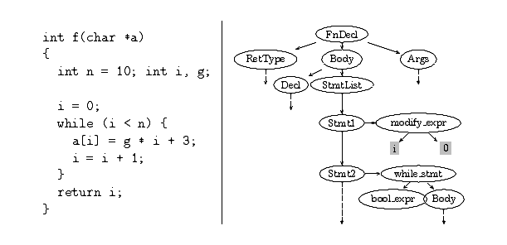
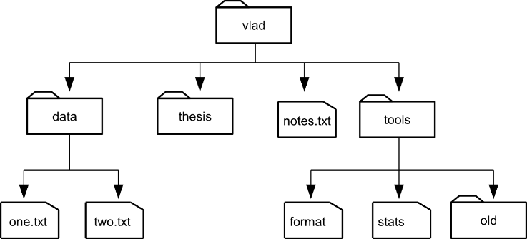
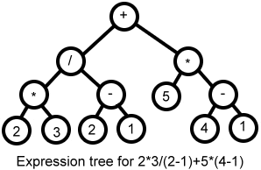
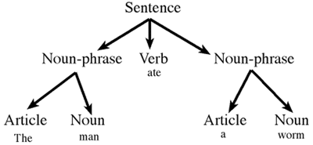
Some Tree Structures

Slide 4
Tree terminology

Slide 5
Tree terminology

Slide 6
Tree terminology

Slide 7
Tree terminology

Slide 8
Tree terminology

Slide 9
Tree terminology

Slide 10
Tree terminology

Slide 11
Tree terminology
Arity/Degree/Order of a tree: Maximum number of children its nodes can have
Nodes of a “$k$-ary” tree can each have at most $k$ children
(Binary trees have at most 2 children)

Slide 12
Tree terminology

Slide 13
Tree terminology

Slide 14
Tree terminology

Slide 15
Tree terminology

Slide 16
Recursive View of Binary Trees
Binary trees have a recursive structure.
For any node in the tree, its left and right children (if any) are the root of a smaller binary tree.
right sub-tree
of a
left sub-tree
of a
Notes:
Left sub-tree of b is the tree rooted at g.
Right sub-tree of f is the tree rooted at f.
Left sub-tree of c is the single node tree e.
What this structure means is that if we want to do something to every node in the tree we can do it recursively.
Imagine I have a function X that can be performed on a node in the binary tree.
Then to apply it to the whole tree I can: {Write on board…}
Do X to whole tree:
Do X to the root
Do X to the left sub-tree
Do X to the right sub-tree
When we do X to the left sub-tree it will recursively…
Do X to the root of that sub-tree (e.g. b)
Do X to the left sub-tree of that sub-tree (e.g. tree rooted at g)
Do X to the right sub-tree of that sub-tree (e.g. tree rooted at f)
The other three traversals are based upon this notion.

Slide 17
Binary Tree Traversals
Four ways to traverse a binary tree:
Level-order traversal
Breadth-first
a b c g f e d h i j
Pre-order traversal
Depth-first
Root, left, right
a b g h i f j c e d
In-order traversal
Left, Root, Right
h g i b j f a e c d
Post-order traversal
Left, Right, Root
h i g j f b e d c a
Note: Our textbook doesn’t mention level-order traversal, but you should know it.

Slide 18
Binary Tree Traversals
Four ways to traverse a binary tree:
Level-order traversal
Breadth-first
a b c g f e d h i j
Pre-order traversal
Depth-first
Root, left, right
a b g h i f j c e d
In-order traversal
Left, Root, Right
h g i b j f a e c d
Post-order traversal
Left, Right, Root
h i g j f b e d c a
Note: Our textbook doesn’t mention level-order traversal, but you should know it.

Slide 19
Distinguish between visiting a node and traversing a subtree
Example: the pre-order strategy of “root, left, right” really means:
Visit the root node
Traverse the left subtree
Traverse the right subtree

Slide 20
Practice: Binary Tree Traversals
Notes:
Level:
Pre:
In:
Post:

Slide 21
Binary Tree ADT
K
V
BinaryTree<K,V> - K = key type, V = value type
size() – total number of nodes
contains(K key) – return true if the tree contains a node with the specified key
V get(K key) – return the value of the node with the specified key (or return null)
set(K key, V value) – set the value of the node with the specified key (or
NoSuchElementException)
add(K key, V value)- add a node with a specified key-value pair to the tree
V remove(K key)- remove a node with the specified key and return its value (or return null)
Visit Pre/In/Post Order(CS232Visitor<K,V> visitor) – visit the nodes in this order and invoke the specified visitor on each node.

Slide 22
Binary Tree ADT
cs232BinaryTree.java (Interface)
cs232Visitor.java (interface)
Note: In our textbook, the binary tree ADT stores a single element at each node, rather than a key-value pair. In the CS232 sample code, we always have a key-value pair at each node. You should be familiar with both definitions.

Slide 23
Full and complete binary trees
complete binary tree: all levels are filled, except lowest level which must start filling from the left
full binary tree: all internal nodes have exactly two children

Slide 24
Perfect binary tree
perfect binary tree: all levels are filled
full but not perfect
complete but not perfect

Slide 25
Activity:
How many nodes are there in a perfect binary tree of height 1, 2, 3, and 4?
How about a perfect binary tree of height $h$?
Can you express the height $h$ as a function of the number of nodes $n$?

Slide 26
Number of nodes in a perfect binary tree
Theorem: A perfect binary tree of height $h$ has $2^{h+1}−1$ nodes.
Proof:

Slide 27
A complete binary tree has logarithmic height
Theorem: If a complete binary tree has $n$ nodes, its height is in $O(\log{n})$.
Proof:

